Slide 1

Analysis 1: Foundations of Modeling Lesson 2.1: Numeral systems
Analysis Team, 2020/2021

Slide 2
Overview of this lesson: Numeral systems
Introduction to numeral systems, a story from the past,
Non-positional numeral systems,
Positional numeral systems,
Face and place value,
BASE,
Binary and hexadecimal systems
Number conversion
Conversion to decimal number
Conversion from decimal number

Slide 3
Overview of this lesson: Numeral systems
Learning objectives:
Understand non-positional and positional numeral systems
Get acquainted with binary and hexadecimal systems
Learn how to convert numbers from one numeral system to another
At the end of the lesson a student should be able to:
Explain the difference between the different numeral systems presented in this lesson
Convert numbers from decimal to binary / hexadecimal and vice-versa

Slide 4
Introduction to numeral systems

Slide 5

Introduction to numeral systems
Can you count the number of apples in the basket and write it down !?
Can you calculate 103 + 40 = ?
Do you know what 0 (zero) is?
Perhaps these questions seems silly nowadays.
2.000 years ago you would be seen as genius (or heretic) if you could answer 2) and 3).
40.000 years ago even 1) was daunting.

Slide 6
Introduction to numeral systems
Numbers and numeral systems are human inventions. To understand it, and the importance it has on computer science, we have to travel to the past.
A long, long, long, long … time ago

Slide 7

Introduction to numeral systems

Slide 8



Introduction to numeral systems
How can Ned count mammoths?

Slide 9
Introduction to numeral systems
For one mammoth, Ned can make one scratch on the wall.
For three, Ned can make three scratches.

Slide 10
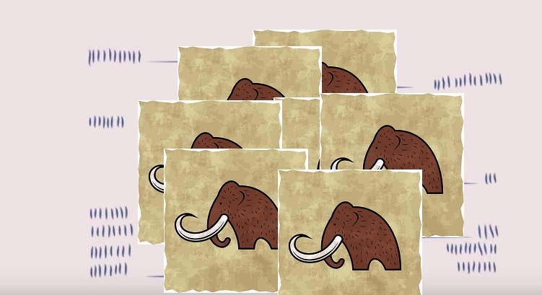
Introduction to numeral systems
For 100 …, well, you get the point. 100 scratches.
It is only a matter of time when Ned will have problem …
How many marks are there?
11
14
8
3
24
23
Notes:
Answer: 83

Slide 11
Introduction to numeral systems
How would you solve the problem?

Slide 12
Non-positional and positional numeral systems

Slide 13
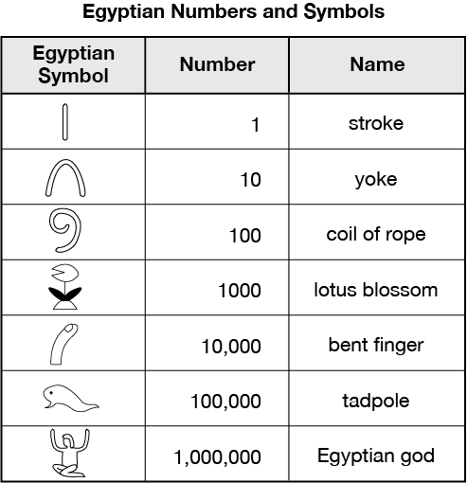
Non-positional numeral systems
Ancient Egyptians made symbol of number (one).
Then, they grouped by 10 and made a new symbol for each.

Slide 14
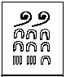
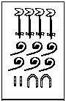
Egyptian numbers and symbols
If you encounter these symbols, could you tell the value?
276
4622

Slide 15
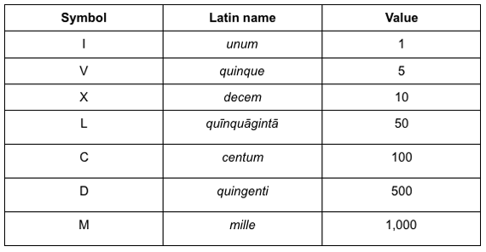
Roman numbers and symbols
Romans had their own version.
Notice they add 5, 50, 500.
Can you say why 5 and 10?
Notes:
Answer: The number of fingers humans have. 5 on each hand. 10 in total.

Slide 16
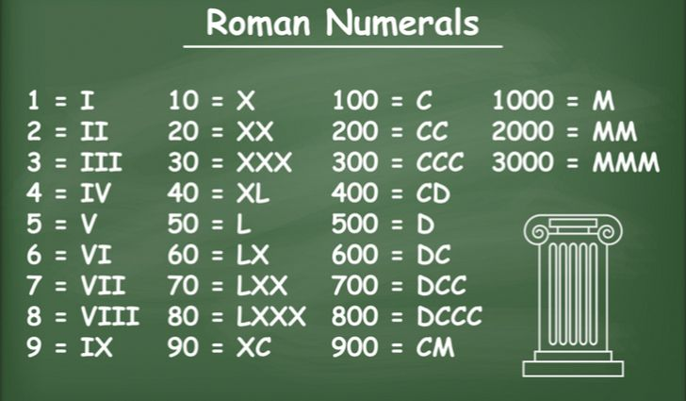
Roman numbers and symbols
Romans also added one more “feature”.
The order matters. If a smaller symbol is IN FRONT of a bigger one, it is SUBTRACTED.
What do you think is the advantage of this approach?
What is disadvantage?
Notes:
Answer: advantage – you can write number with fewer symbols. Disadvantage – reading becomes more complicated (you have to add and subtract)

Slide 17
Roman numbers and symbols
What is the value of the following:
V I I I
I X
M C D X X I I
= 8
= 9
= 1422

Slide 18
Non-positional numeral systems
Egyptian and Roman numeral systems represent NON-POSITIONAL NUMERAL SYSTEMS.
However, with Romans that distinction is not as clear as with Egyptians.
In NON-POSITIONAL NUMERAL SYSTEM, each symbol represents the same value regardless of its position.
Notes:
If students wonder why is IV non-positional, since IV and VI is not the same; please explain that Romans treat ‘IV’ as one (unique) symbol, and the same applies for ‘VI’ which is also treated as one symbol.

Slide 19
Positional numeral system
The most common numeral system is Hindu-Arabic, or Indo-Arabic.
It is a positional decimal numeral system and is the one we use today.
Invented between I and IV century by Indian mathematicians.
Adopted by Arab mathematicians in IX century.
Spread to medieval Europe in late middle ages.
The system was originally based on 9 symbols (glyphs), to be later extended to 10.

Slide 20
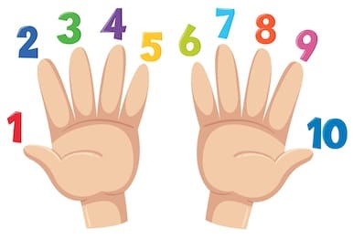
Positional numeral system
We already mentioned that we (humans) like number 10, because we have 10 fingers.
The idea is that we keep counting until we reach some limit – base.
Then we start again, but change position.

Slide 21
Positional numeral system
1
2
3
4
5
6
7
8
9
1 _
The idea is that we keep counting until we reach some limit – base.
Then we start again, but change position.
We call it positional system as the position of the symbol determines its value.
Note that the symbol is the same, but the value is not.

Slide 22

Invention of zero
This created a need for a new symbol: 0 (zero).
ZERO has twofold importance:
It shows that there is no amount (e.g. There were four apples in the basket and we ate four. How many are left? 4 – 4 = 0 )
It is a placeholder (e.g. if we write 1 2, what is that?
Is that 1 and 2, or 12 or one hundred and two)
1 2
102

Slide 23
Face and place value
Let’s take one symbol. E.g. 4.
If we write it down as: its value is … four. ☺
This is called: face value.
If we write the same symbol as part of a larger number, e.g. 1 2 4 9, its value is determined by its place.
In number: our symbol has value … forty.
This is called: place value.
4
1 2 4 9

Slide 24
Face, place value and base
Lets take a look at the number 1249 again.
Its value is determined by the value of its symbols in relation to their place.
1 – one thousand: 1 * 1000 = 1 * 10³
2 – two hundred: 2 * 100 = 2 * 10²
4 – forty: 4 * 10 = 4 * 10¹
9 – nine: 9 * 1 = 9 * 10⁰ = 9 * 1
_______
1*1000 + 2*100 + 4*10 + 9*1 = 1249

Slide 25
Face, place value and base
1 – one thousand: 1 * 1000 = 1 * 10³
2 – two hundred: 2 * 100 = 2 * 10²
4 – forty: 4 * 10 = 4 * 10¹
9 – nine: 9 * 1 = 9 * 10⁰ = 9 * 1
_______
1*1000 + 2*100 + 4*10 + 9*1 = 1249
PLACE VALUE
BASE
FACE VALUE

Slide 26
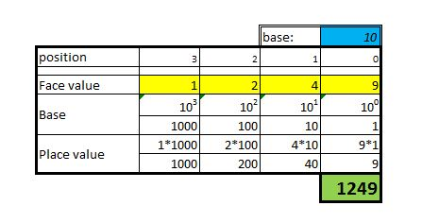
Converting to decimal
Knowing this, we can make a table to convert any number to base 10 number.

Slide 27
Converting to decimal
Hold on!
Isn’t 1249 ALREADY base 10 number!!!???
Knowing this, we can make a table to convert any number to base 10 number.
Yes it is!
So 1249 in base 10 (we can write it as 1249₁₀) is indeed the number we know as ONE thousand TWO hundred and FORTY NINE.
But this will change …

Slide 28
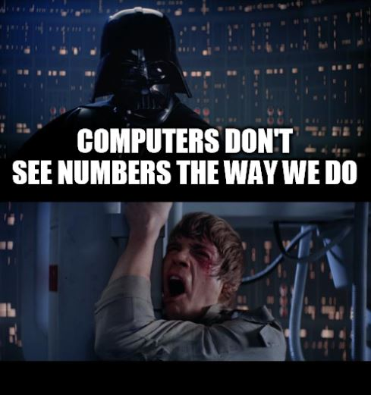

Slide 29
Binary system

Slide 30

Introducing numbers to machines
Numbers are human “constructs”.
As such they are way too complex for machine to grasp.
Cybernetics pioneers had to find a way to make machines “understand” our numeral system.
So, … what is the most simple form a machine can understand?

Slide 31
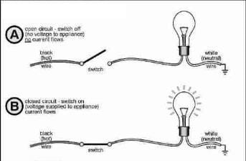
Introducing numbers to machines
We can make the machine recognize a certain state – a circuit with electric charge (closed).
Then, we can make another state that is the opposite – a circuit without electric charge (open).
Machines can understand more than two states, but electronics with only two states are less error prone. Therefore, we distinguish between:
Open circuit - ZERO ( 0 )
Closed circuit - ONE ( 1 )

Slide 32
Introducing numbers to machines
Speaking in terms of human evolution, it would be like if we were born with only one finger on each hand.

Slide 33
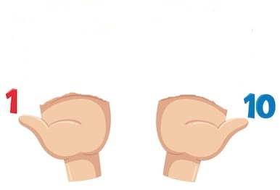
Introducing numbers to machines
Human
Computer

Slide 34
Binary system
Therefore, computer Neanderthal would count using BASE 2, instead of BASE 10.
Numbers of base 2 are:
0
1
10
11
100
101
110
111
We call it the BINARY SYSTEM.

Slide 35
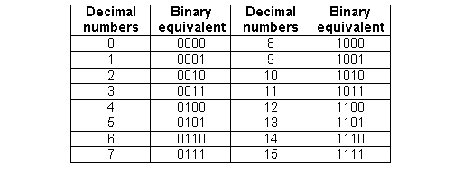
Binary system
100 in binary is NOT equal to 100 in base 10.
To make a distinction, we write the base as subscript next to the number.
100₂ ≠ 100₁₀.
100₂ = 4₁₀

Slide 36
Binary system
Can you solve the following addition:
110₂ + 111₂ = ?
Not so easy! Right?
That is because our brain is “trained” to think in base 10. Although this is simple addition, it still takes us some time.
110₂ + 111₂ = 1101₂ or
6₁₀ + 7₁₀ = 13₁₀

Slide 37
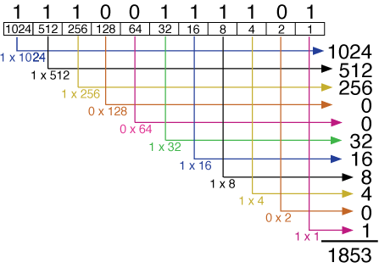
Converting from binary to decimal
As we know how to convert numbers to base 10 and that computers count in binary, we can easily convert any binary number to decimal.

Slide 38
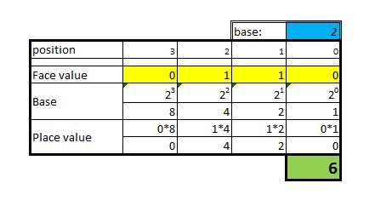
Converting from binary to decimal
We can use the table from the previous slides before Ned intervened.
We change base to 2 and enter number 110₂.

Slide 39
Conversion exercise
Convert following binary numbers to decimal:
1000₂
1110₂
0101₂
0000₂
1111₂
1001₂
0251₂
This one is wrong – impossible.
A trick question to see if you were paying attention. ☺

Slide 40
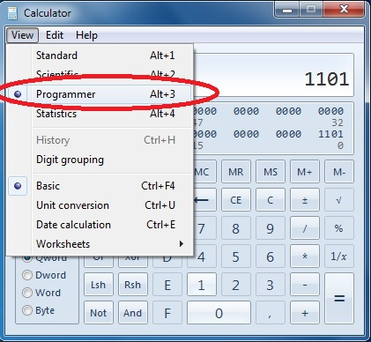
Conversion from binary to decimal
You can double-check our result with windows calculator. Set it to programmer under view.
Use it to familiarize yourself with binary numbers.

Slide 41
Conversion from base 10 - decimal

Slide 42
Converting from decimal … Algorithm
Use the following algorithm to convert base 10 number to other base:
Use FLOOR division to divide given number with target base,
Store A) quotient (result; whole number) and B) remainder
Write B) remainder (from right to left)
If A) quotient is not ZERO, go back to step 1. and repeat the process with A) quotient as the new input.
Read written numbers from left to right.

Slide 43
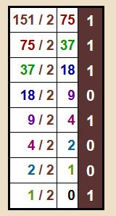
Converting from decimal …
Apply the algorithm to convert 151₁₀ to binary.
Thus, we conclude that
151₁₀ = 10010111₂.
1
1 1
1 1 1
0 1 1 1
1 0 1 1 1
0 1 0 1 1 1
0 0 1 0 1 1 1
1 0 0 1 0 1 1 1

Slide 44
Hexadecimal system

Slide 45
Hexadecimal and octal numbers
The computer can understand binary numbers, but they are not always practical. The sequence can get very long.
We can convert binary to any other system that has base of power of 2 (e.g. 2² = 4, 2³ = 8, 2⁴ = 16, … )
Numeral system with base 8 is also called OCTAL.
Numeral system with base 16 is also called HEXADECIMAL.

Slide 46
Hexadecimal system
Moving to base 16 means we have 16 sequential numbers (including 0) as base units.
That means we have to “invent” 6 more numbers greater than 9 and smaller than 10.
1 7 D
2 8 E
3 9 F
4 A 1 0
5 B 1 1
6 C 1 2

Slide 47
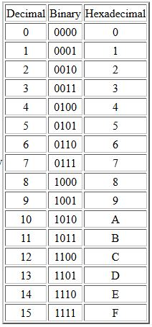
Comparison: decimal, binary and hexadecimal values

Slide 48
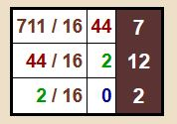
Conversion exercise
We know how to convert ANY base to base 10 and vice-versa.
Apply the conversion algorithm to convert 711₁₀ to hexadecimal.
Thus we conclude that
711₁₀ = 2C7₁₆.

Slide 49

Conclusion
There are only 10 types of people in the world:
-----------------------
Those who understand BINARY and those who don’t.

Slide 50
Summary Quiz
What types of numeral systems have we been using throughout the history to represent numerical values?
How are numbers represented in the earliest numeral system(s)?
Why were the early symbols focusing on values divisible by 5 and 10?
Which advancements / changes did the introduction of Hindu-Arabic, or Indo-Arabic system brought?
What is the purpose of zero?
What is base?
Why are binary numbers used in computer science?
Why are hexadecimal and octal numbers also used in computer science? What is the base for each?
How do you convert from and to decimal number?

Slide 51
Summary
In our history, we have used non-positional and positional numeral systems to represent numerical values.
In a non-positional numeral system, each symbol represents the same value regardless of its position. The numerical value is determined through the addition of values.
We (humans) natively use the decimal system. The main reason is the number of fingers on our hands, 5 + 5 = 10. That is why early symbols were all values divisible by 5 and 10.
The decimal positional numeral system (Hindu-Arabic, or Indo-Arabic) uses 10 symbols and the value of each symbol is determined by its face and place value. Thanks to positional numeral systems, mankind could easily express large numbers without the need for addition (and subtraction).
Zero has a twofold purpose: as placeholder and no value.
The base is the number of different symbols – digits (and letters) that a system of counting is using to represent numbers.

Slide 52
Summary
Machines cannot understand the notion of numbers. At best they can differentiate between two states: circuit open and circuit closed. That is equivalent to base 2 or the binary numeral system.
The hexadecimal and octal systems are used because binary numbers are not always practical (the sequence can get very long). The base for hexadecimal is 16 and for octal is 8. Each hexadecimal numeral corresponds to 4 binary bits, and each octal numeral corresponds to 3 binary bits.
Conversion from and to decimal numbers is covered in slides 37 – 43.

Slide 53
Extra material - videos
Disclaimer:
The following videos are not part of the course material, and as such, are treated as an extra information. The teaching team believes it is beneficial to the students to also have the topics presented from a different perspective. Some video will provide more information that given at the lesson, some less.
For the exam, the only relevant information is considered the one given by the teachers and written in the course book.
To understand the topics better, using external sources, like the videos given below, is strongly recommended. Feel free to explore, and ask your teacher should you have any questions.

Slide 54
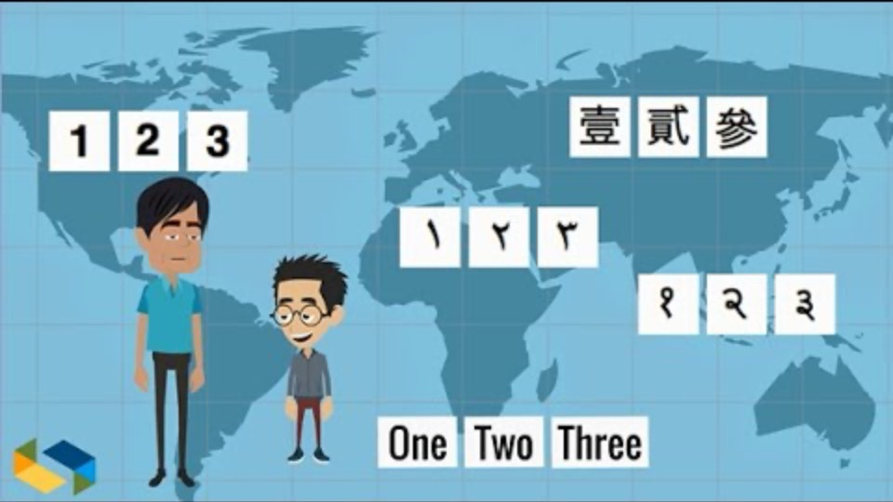
Number systems – basic concepts

Slide 55
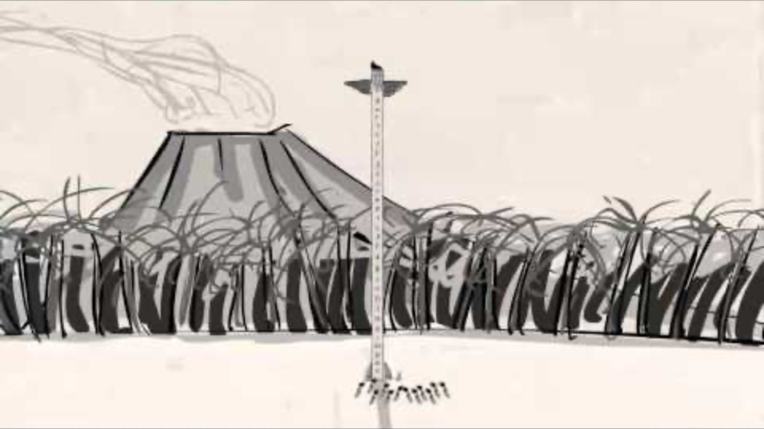
MyWhyU – The dawn of numbers (part 1)

Slide 56
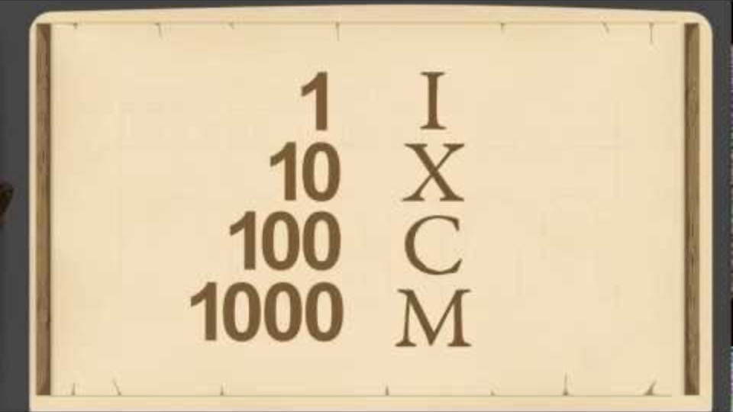
MyWhyU – Single value vs. positional notation (part 2)

Slide 57
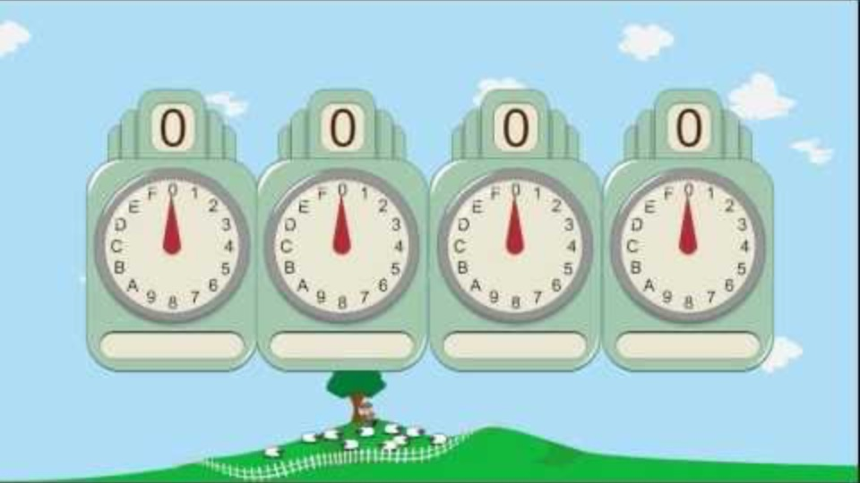
MyWhyU – Decimal, binary, octal and hexadecimal (part 3)

Slide 58
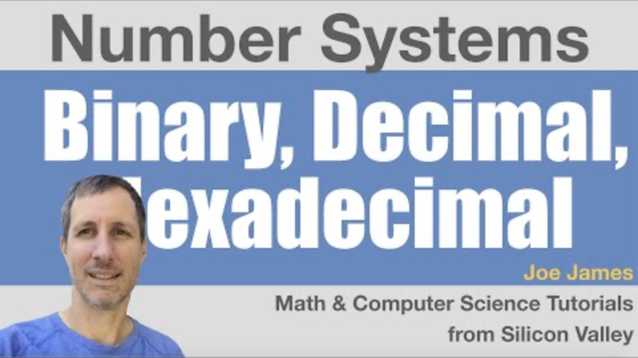
Converting numbers

